Slide 1
Task-12 Cost optimization and budgets done by varaprasad

Slide 2
Introduction of cost optimization:
Cost optimization in AWS (Amazon Web Services) refers to the process of reducing and managing the overall cost of using AWS cloud resources while maintaining performance, security, and scalability. Effective cost optimization ensures that an organization is only paying for the resources it needs, at the most appropriate price, and is aligned with its cloud strategy.
Key Strategies for AWS Cost Optimization:
Right-Sizing Resources:
Analyze usage: Regularly monitor your resource usage (EC2 instances, RDS databases, etc.) to ensure they are properly sized for your workload. Use AWS tools like AWS Cost Explorer or AWS Compute Optimizer to identify underutilized resources.
Adjust instance types: For example, switch from larger instance types to smaller ones or use instances that are more suited for your actual needs.
Use Reserved Instances (RIs) and Savings Plans:
Reserved Instances: Purchase RIs for EC2, RDS, and Redshift if you have predictable workloads. This provides discounts (up to 75%) compared to On-Demand pricing in exchange for a one- or three-year commitment.

Slide 3
Savings Plans: These are flexible pricing models that allow you to save on EC2, Lambda, and Fargate usage. They provide similar savings to RIs but with more flexibility around instance families and regions.
Utilize Spot Instances:
Spot Instances are unused EC2 capacity that AWS offers at a significant discount (up to 90%). They are ideal for stateless, fault-tolerant workloads or batch processing where interruptions can be tolerated.
EC2 Spot Fleet: This lets you manage a collection of spot instances, automating the procurement and scaling
Auto Scaling:
Auto Scaling adjusts the number of EC2 instances, containers, or other resources based on demand. This ensures you only use the necessary resources during peak times and scale down when not needed.
Use Elastic Load Balancing (ELB) along with Auto Scaling to distribute traffic evenly across instances and reduce over-provisioning.

Slide 4
Storage Cost Management:
S3 Lifecycle Policies: Move infrequently accessed data to more cost-effective storage tiers (e.g., S3 Glacier or S3 Intelligent-Tiering) to optimize storage costs.
EBS Snapshots and Volume Optimization: Delete unused snapshots and volumes, and use EBS volume types that match the performance required for workloads (e.g., use GP3 instead of GP2 for cost savings).
Amazon EFS: Use Amazon EFS for file storage, but ensure the storage class and access patterns are aligned with your needs.
Use AWS Cost Explorer and AWS Budgets:
Cost Explorer: Helps visualize your cost patterns and usage over time. You can identify trends and anomalies that suggest opportunities for optimization.
AWS Budgets: Set custom cost and usage budgets. This helps track spending and receive alerts when thresholds are breached, allowing for proactive cost management.

Slide 5
Networking Optimization:
Data Transfer: Minimize data transfer costs by reducing cross-region traffic or optimizing the use of Content Delivery Networks (CDNs) like Amazon CloudFront.
VPC Peering vs. Transit Gateway: When designing network architectures, choose the most cost-effective option for connecting VPCs and inter-region communications.
Optimize Databases:
Amazon RDS: Use features like automated backups, scaling based on usage, and proper instance sizing. Also, you can switch to Amazon Aurora, which may offer cost advantages due to its efficient scaling and high performance.
Amazon DynamoDB: Use on-demand capacity mode for unpredictable workloads and provisioned mode for predictable workloads with auto-scaling.

Slide 6
Tools for Cost Optimization:
AWS Trusted Advisor: Provides best practice recommendations in cost optimization, security, performance, and fault tolerance.
AWS Cost and Usage Report (CUR): A detailed, CSV-based report that gives insights into the cost and usage patterns, allowing for deep analysis.
AWS Cost Explorer: Offers detailed visualizations of your usage and spending patterns.
AWS Compute Optimizer: Helps optimize EC2 instances and Auto Scaling configurations based on usage data.
AWS Lambda Power Tuning: A tool that helps optimize the cost of AWS Lambda by providing recommendations on memory allocation.

Slide 7
Introduction of aws budget:
AWS Budgets is a service provided by Amazon Web Services (AWS) that helps you monitor and control your AWS usage, costs, and service limits. It allows you to set custom budgets for different aspects of your AWS usage, such as cost, usage, or reservation utilization, and then receive notifications when your usage or costs approach or exceed the set thresholds. This makes it a valuable tool for cost management and optimizing cloud expenses.
Key Features of AWS Budgets:
Customizable Budget Types:
Cost Budget: You can set a budget to track your overall costs or the costs for specific AWS services, linked accounts, or cost categories. This helps you stay on top of your AWS expenses.
Usage Budget: You can set a budget to track your usage of specific AWS services or resources (e.g., EC2 instance hours, S3 storage usage) and get notified when usage exceeds the specified threshold.
Reservation Budget: This allows you to monitor the utilization of your Reserved Instances (RIs) or Savings Plans, ensuring you're making the most of your purchased capacity.

Slide 8
Budget Filters:
You can filter your budget based on various attributes such as:
Linked accounts: Track and manage the costs for individual AWS accounts within an organization.
Cost categories: Track specific categories of costs, such as development or production environments.
Services: Track costs for specific AWS services, such as EC2, S3, or RDS.
Linked resources: Filter budgets based on specific tags, usage types, or regions.
Budget Reports:
You can generate reports to view your budget performance over time. These reports can give you insights into your actual versus budgeted costs, helping you identify areas where you might need to optimize usage.

Slide 9
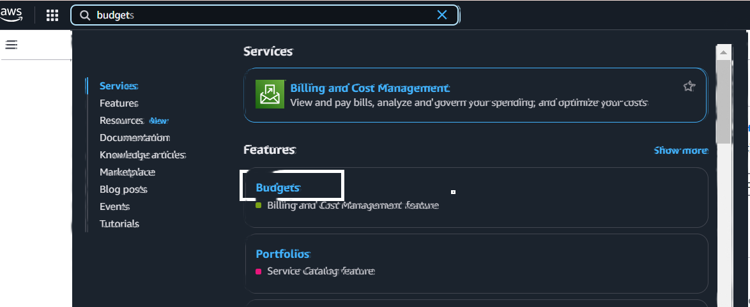
How AWS Budgets Works:
Step 1 :
Firstly login aws console and search bar in aws budget.

Slide 10
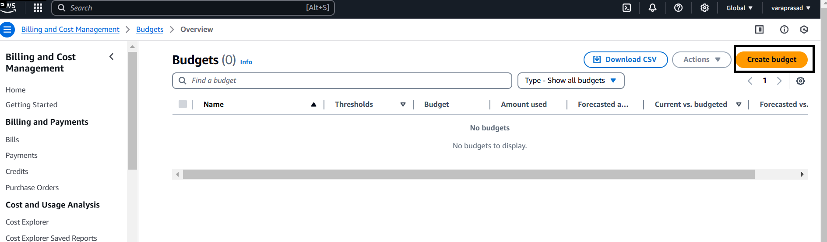
Login page should be open its shown below :
Here select create budget
To start, you need to create a budget in the AWS Budgets console. You’ll choose the budget type (cost, usage, or reservation), define the parameters (e.g., linked account, service, region), and set the budget limit.

Slide 11
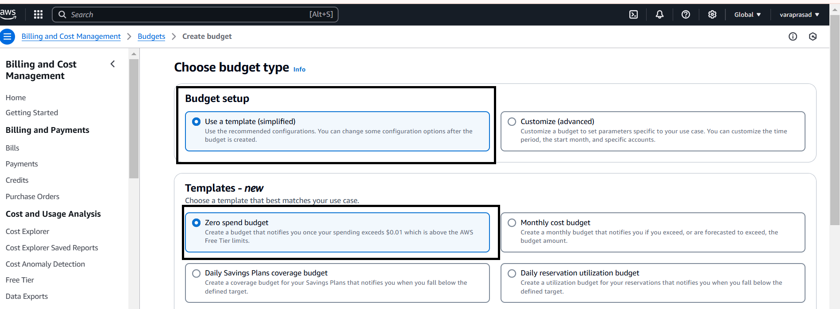
Set Budget Parameters:
Here select use a template
In templates I select zero spend budget

Slide 12
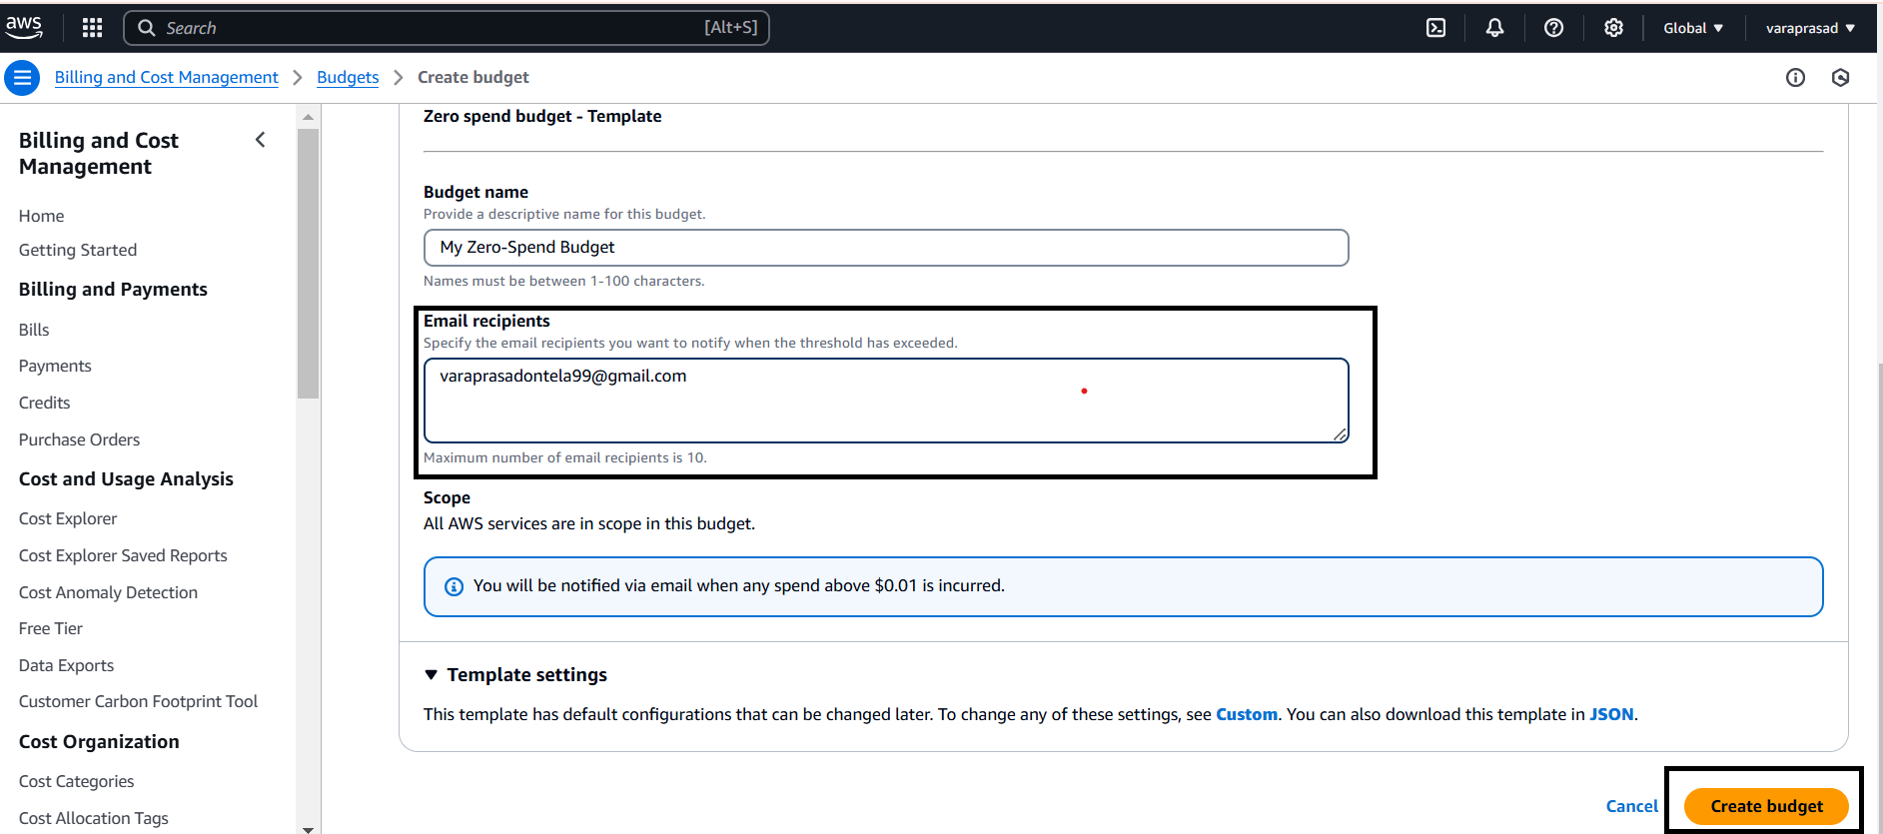
Set Notifications and Alerts:
Here give budget (name).
Give your aws console mail for notification alerts.
And next create budget.

Slide 13
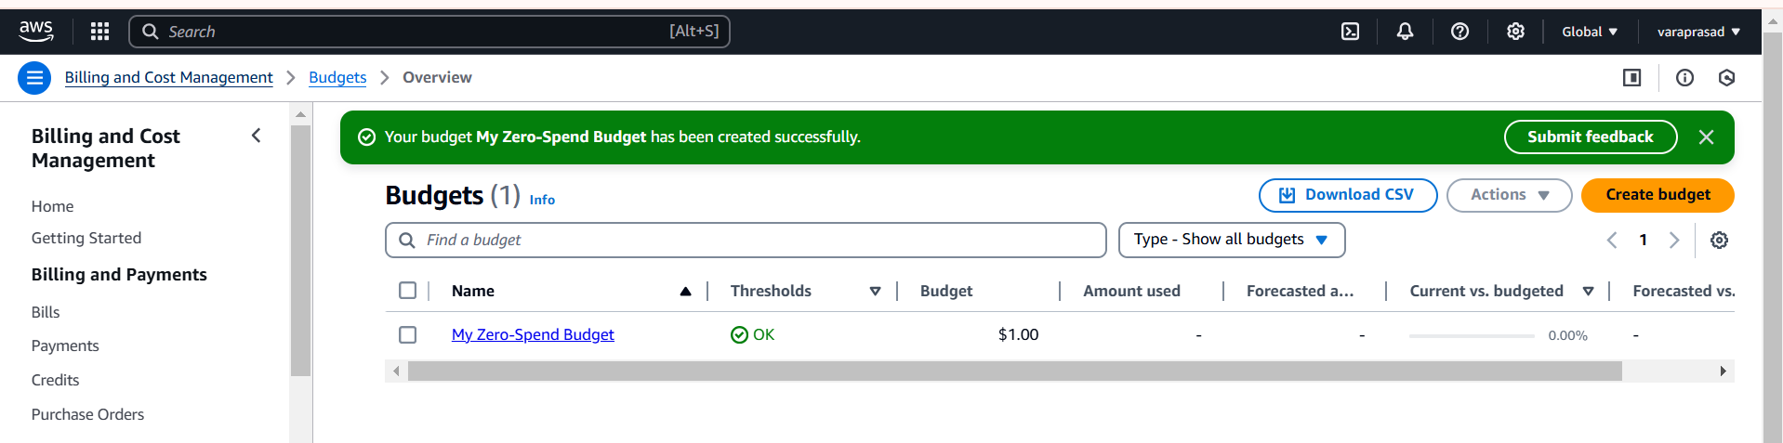
Budget has been created its shown below:

Slide 14
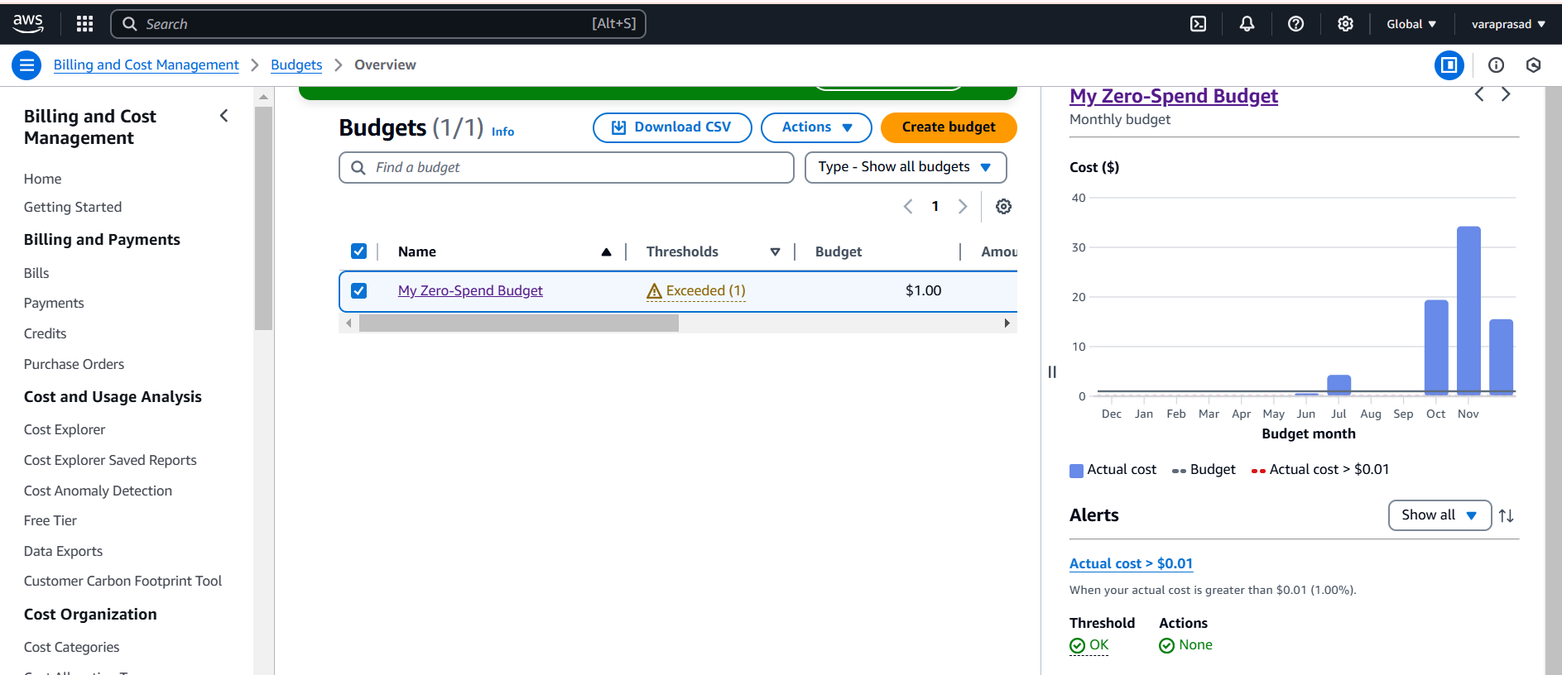
Monitor our Budget:

Slide 15
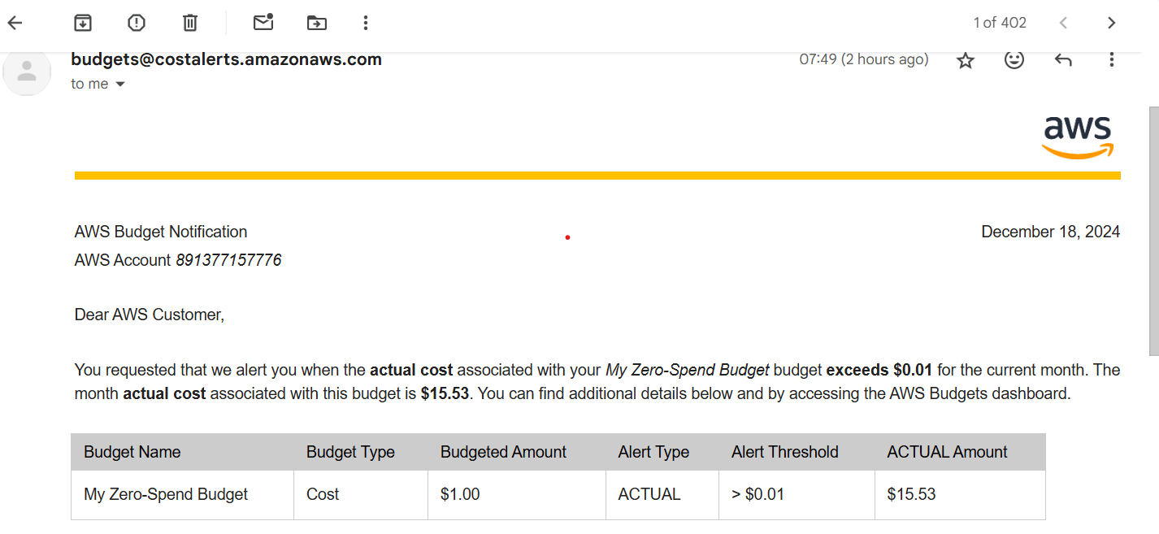
Notifications and Alerts:
After creating the budget, you can set up notifications at various thresholds (e.g., 50%, 80%, 100%). Notifications are sent to the email addresses or SNS topics you provide.
You can also create custom actions based on alerts, such as triggering an automation (via AWS Lambda or SNS) when a budget threshold is breached.
Here its shown below:

Slide 16
Lets create another budget for monthly.
Here Create a budget

Slide 17
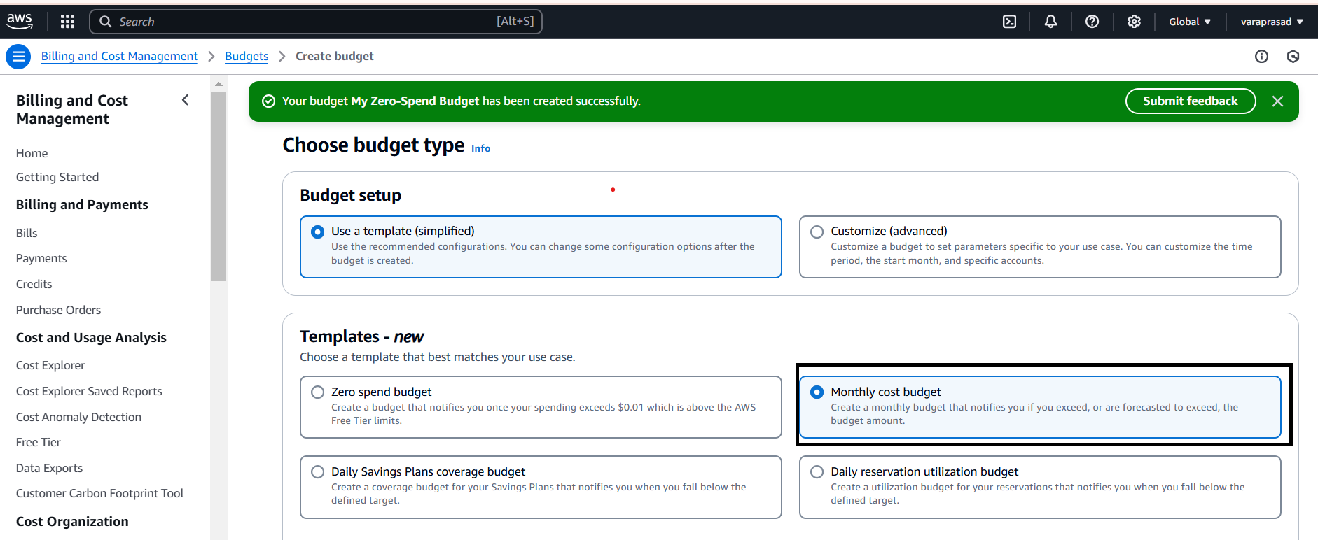
Set Budget Parameters:
Here select use a template
In templates I select monthly cost budget.

Slide 18
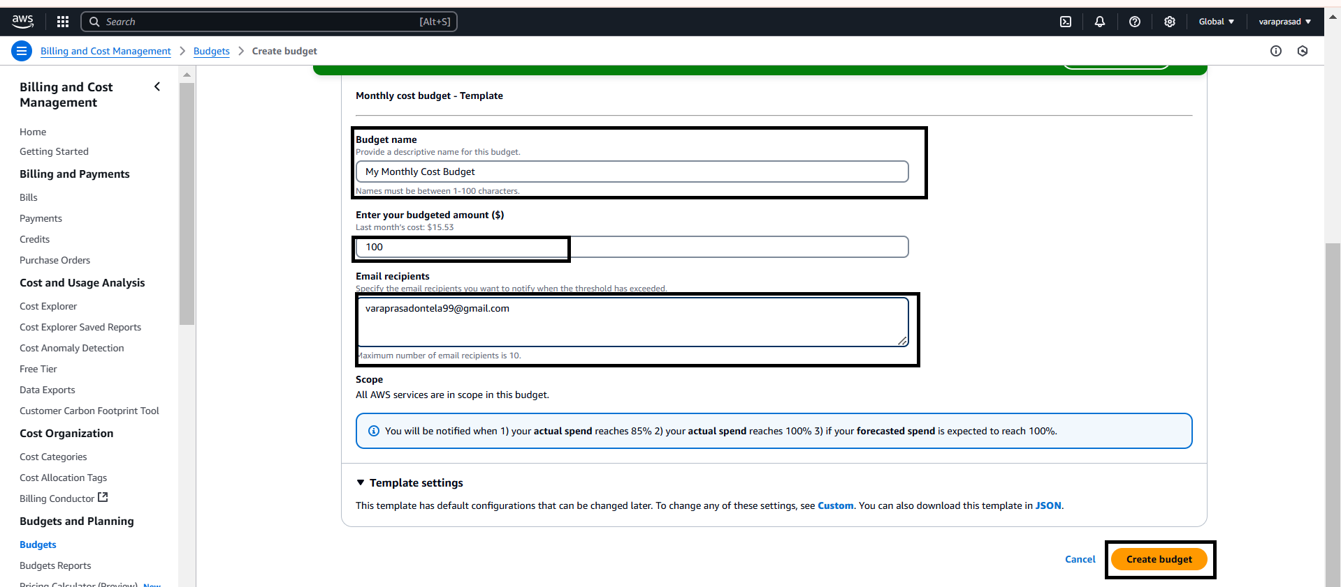
Set Notifications and Alerts:
Here give budget (name).
Enter our budget amount.
Give your aws console mail for notification alerts.
And next create budget.

Slide 19
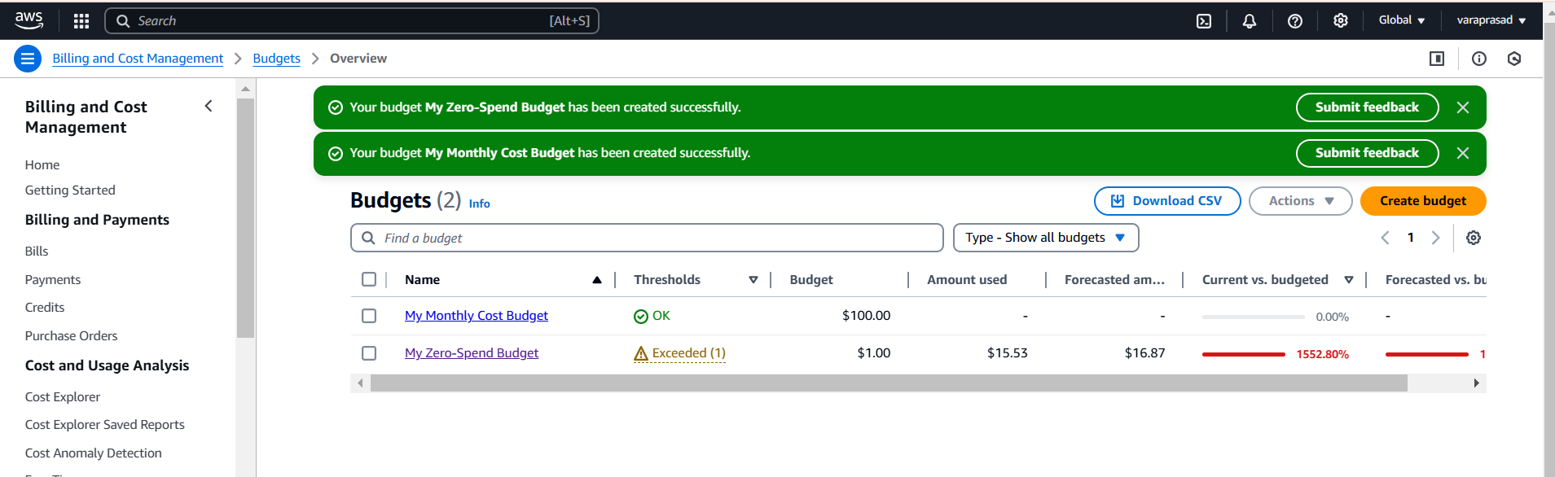
Monthly Budget has been created its shown below:

Slide 20
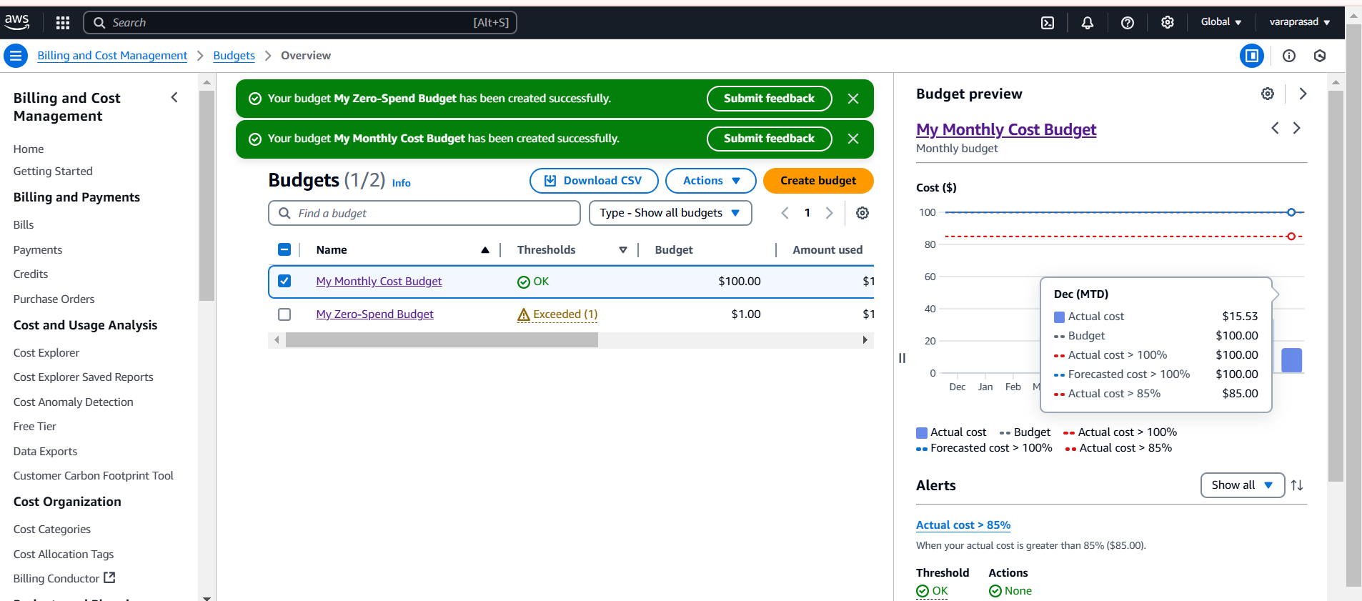
Monitor our budget its shown below:

Slide 21
Lets create another budget for daily.
Here Create a budget

Slide 22
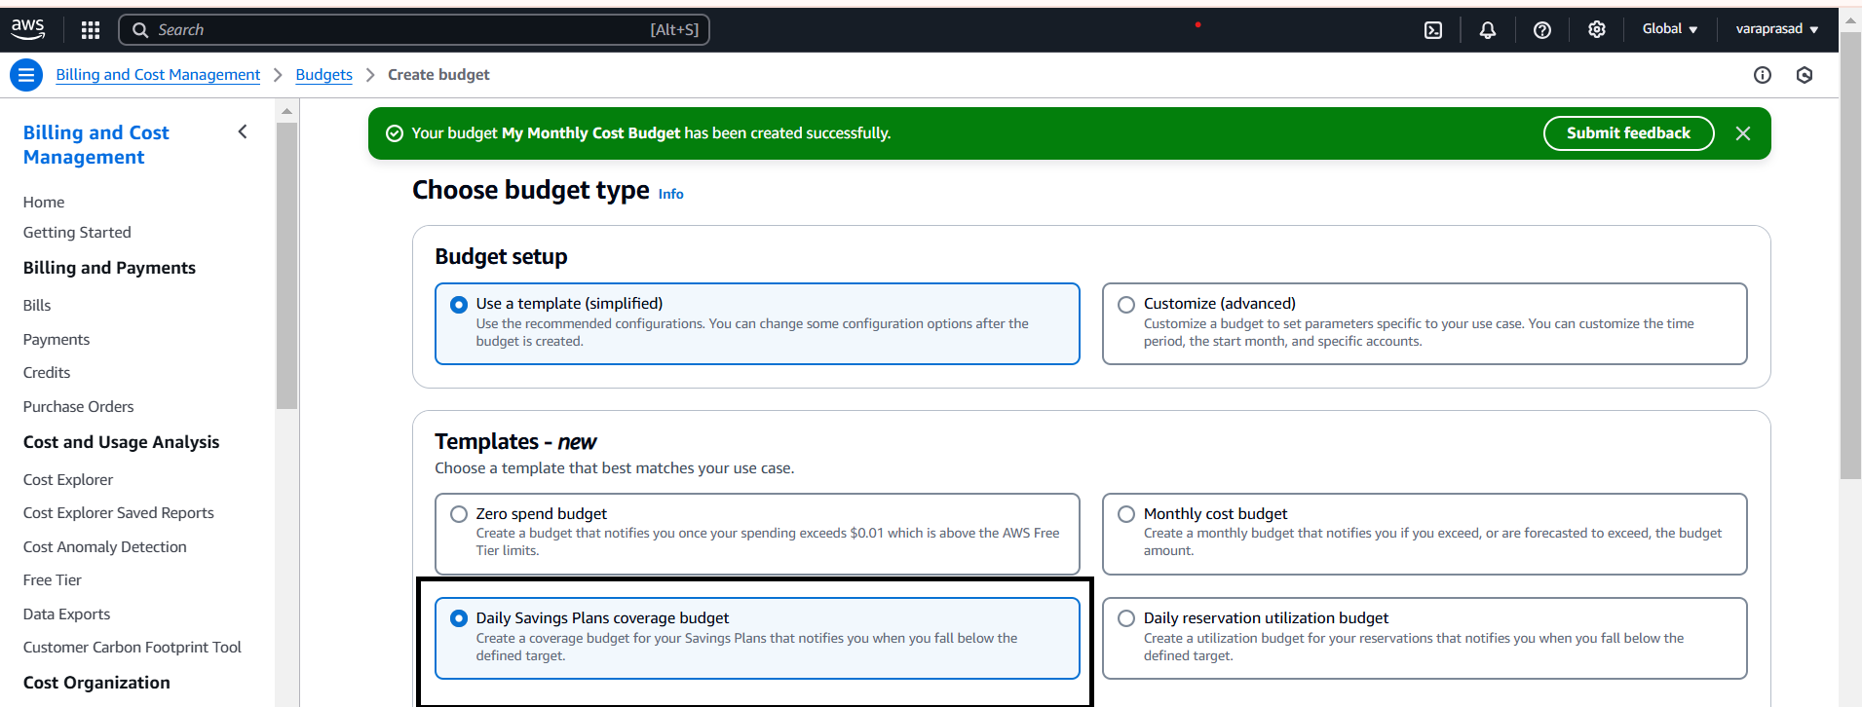
Set Budget Parameters:
Here select use a template
In templates I select daily saving plans.

Slide 23
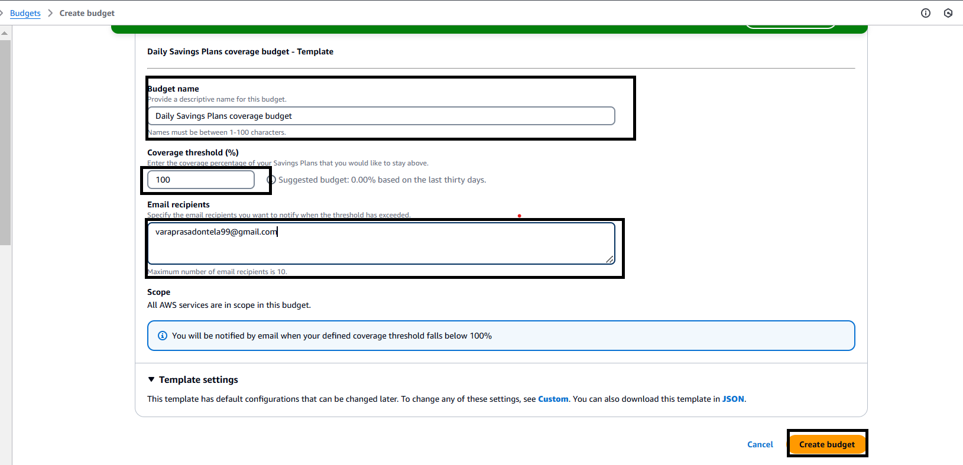
Set Notifications and Alerts:
Here give budget (name).
Enter our budget amount.
Give your aws console mail for notification alerts.
And next create budget.

Slide 24
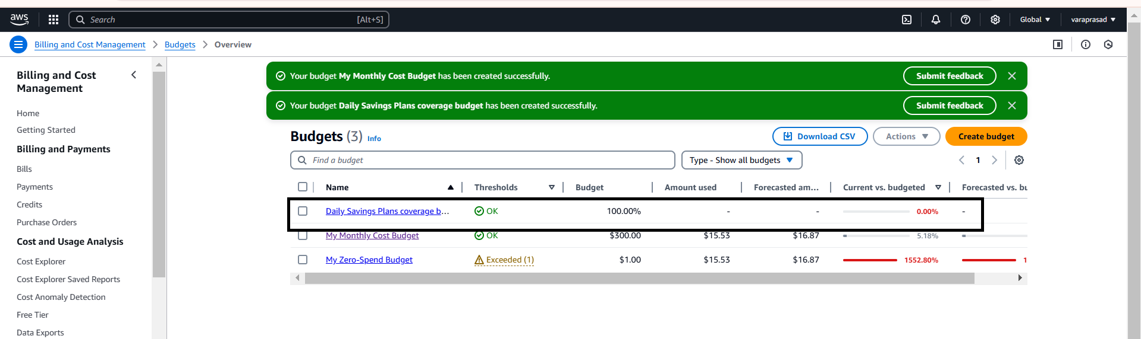
Daily Budget has been created its shown below:

Slide 25
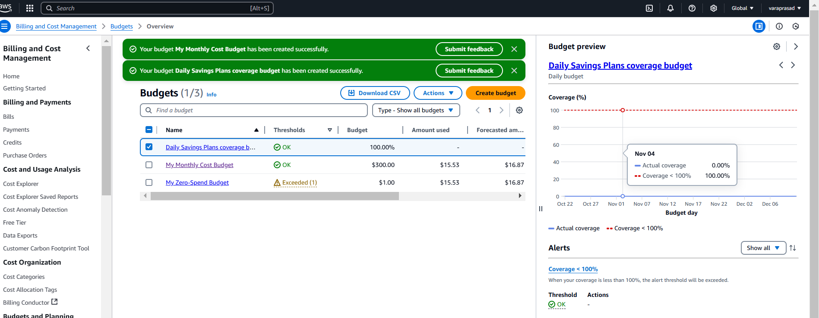
Monitor our budget its shown below:

Slide 26
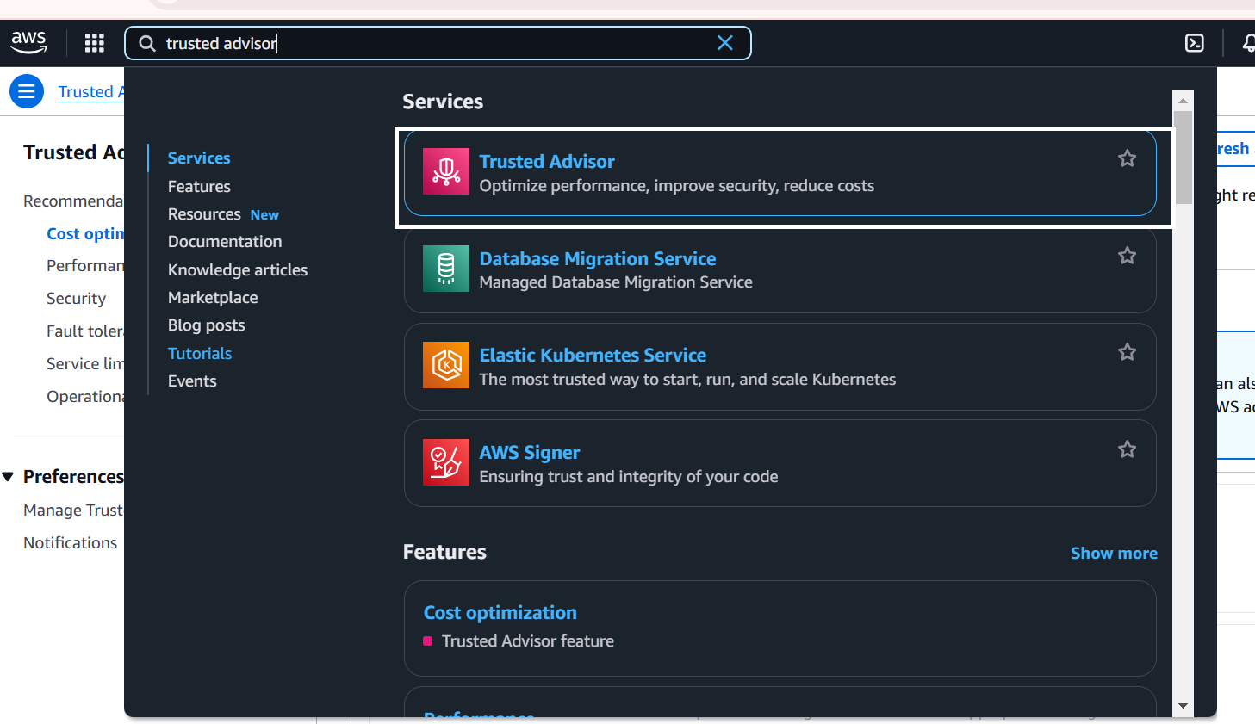
Step 2 :
Cost optimization :
Login aws console search aws trusted advisor

Slide 27
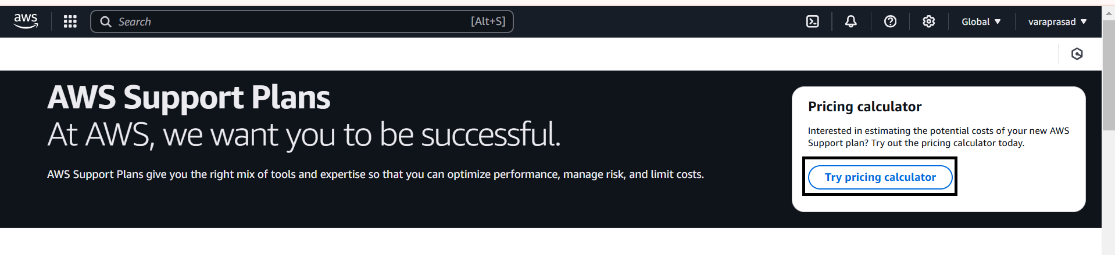
Cost optimization login page should be open
Here select try pricing calculator
Pricing calculator:The AWS Pricing Calculator is a tool provided by Amazon Web Services (AWS) that helps estimate the cost of your AWS services based on your specific use case, allowing you to calculate potential costs for your infrastructure and services before committing to them. The tool helps you plan and optimize costs by customizing your selections to match your exact needs. Here's a breakdown of the tool and how it can aid in cost optimization:

Slide 28
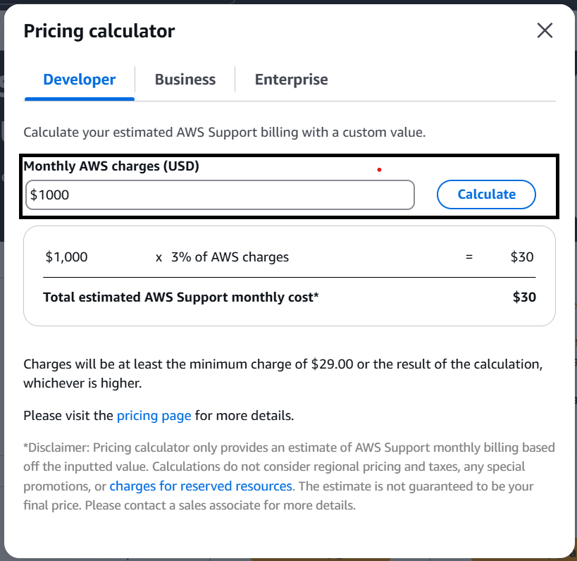
Estimate Costs for aws charges for developer:
Monthly aws charges (usd) I can give (1000) and I calculate.
Monthly aws charges (usd) its shown below.

Slide 29
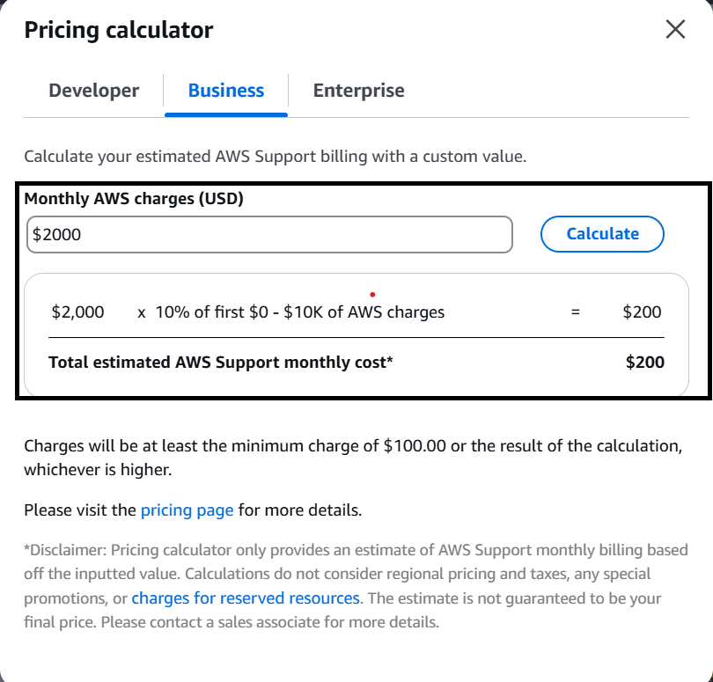
Estimate Costs for aws charges for business:
Monthly aws charges (usd) I can give (2000) and I calculate.
Monthly aws charges (usd) its shown below.

Slide 30
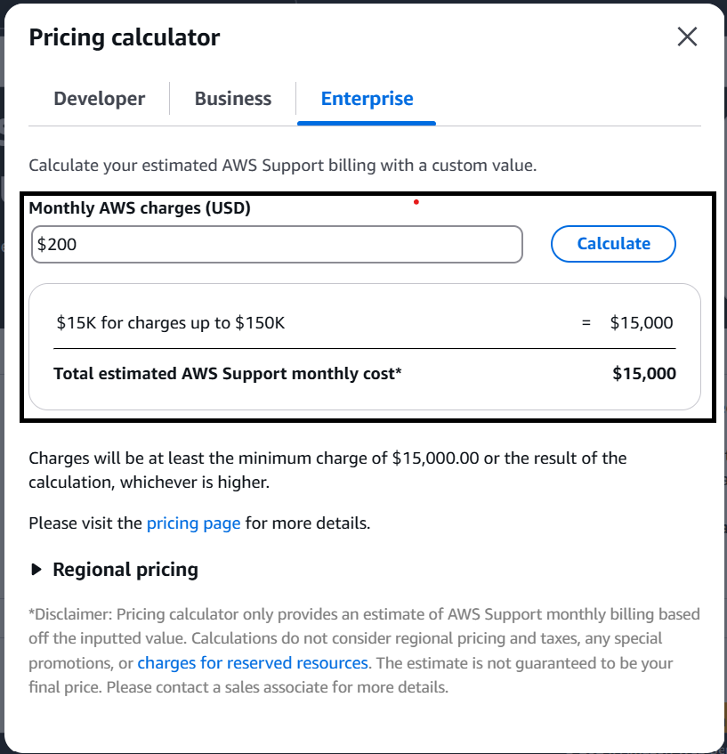
Estimate Costs for aws charges for Enterprice:
Monthly aws charges (usd) I can give (200) and I calculate.
Monthly aws charges (usd) its shown below.

Slide 31


